Slide 1















Form Filling Project presentation
By Harini P

Slide 2

Filling Forms – A Tedious Task?
Manual form-filling is time-consuming and error-prone.
Individuals with physical disabilities face accessibility challenges.
Need for automation and a user-friendly solution.

Slide 3
01.
Voice Recognition: Use of speech-to-text technology.
Voice-Based Form Filling: The Technical Solution
Backend Logic: Flask-based server that handles form submission and validation.
02.
03.
Database Integration: MySQL for storing user data and form entries.
04.
Security Measures: Password hashing and secure
communication.

Slide 4
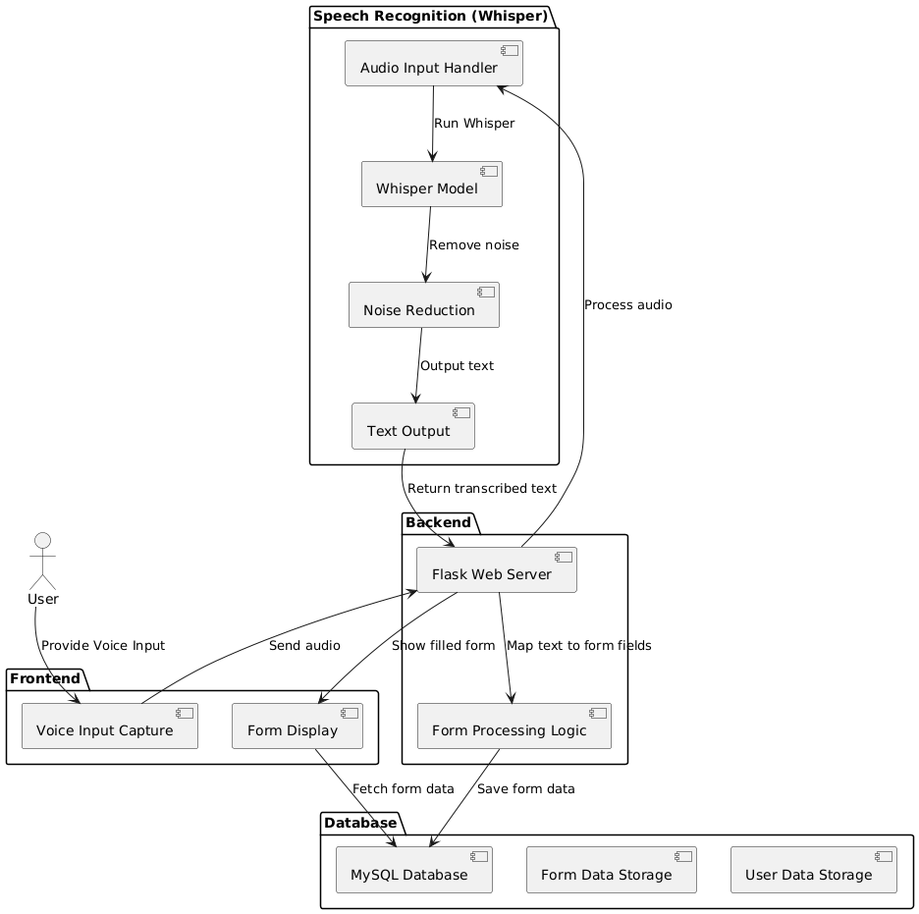
System Architecture–
The Building Blocks

Slide 5
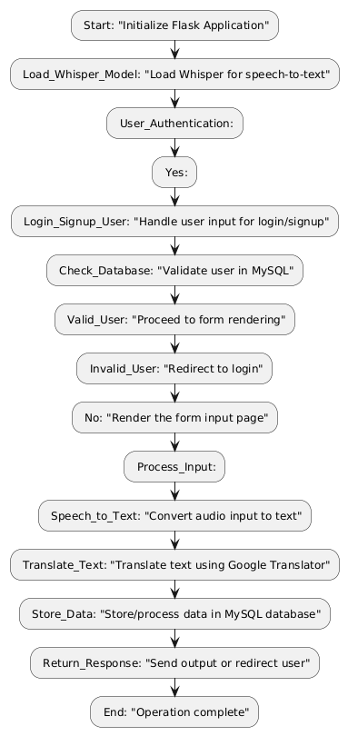
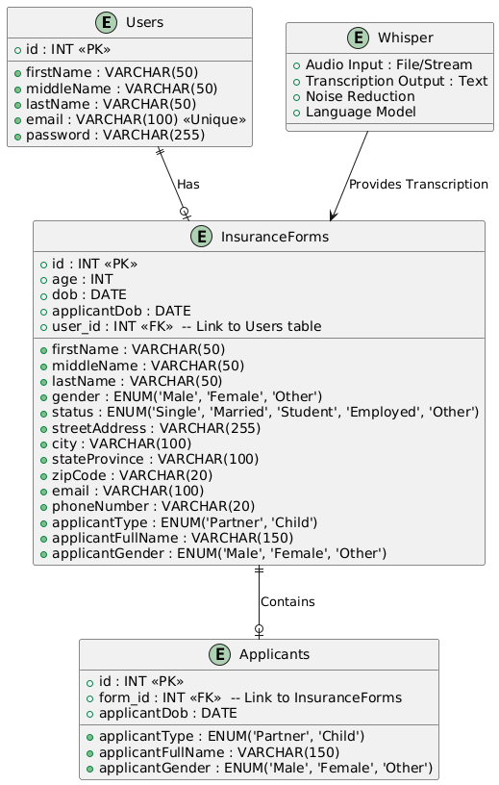
Flow
DB

Slide 6
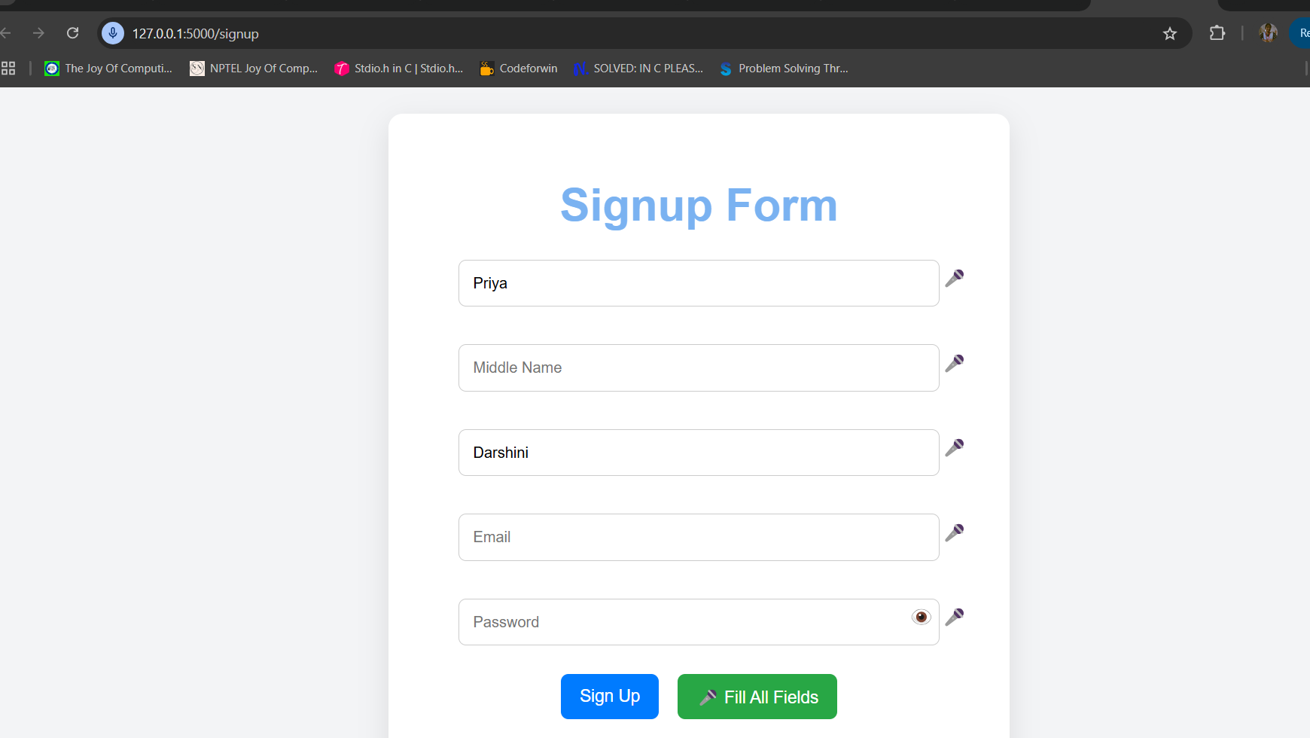
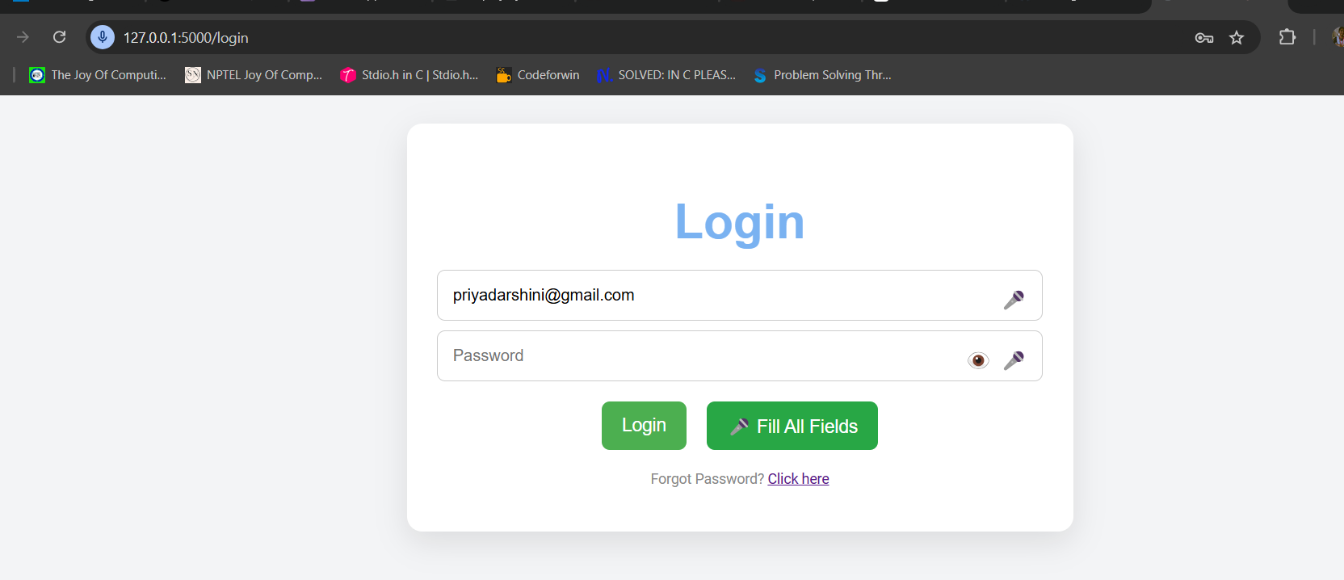

Slide 7
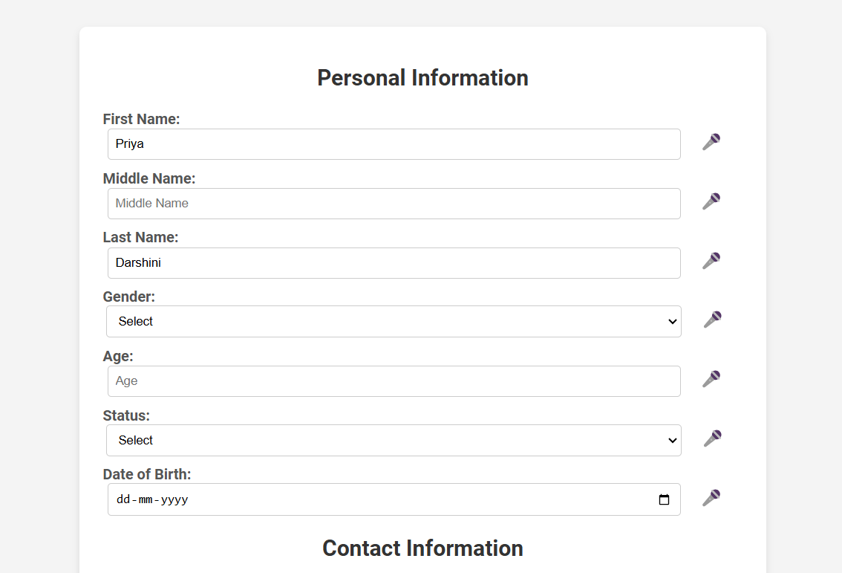
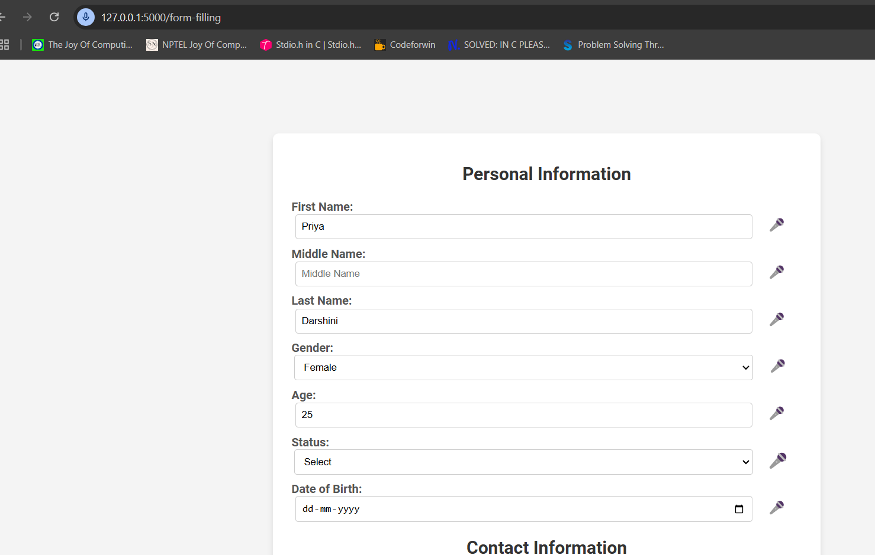
P
Prefilled details from database

Slide 8

Deployment Part
Deployment is done using ‘Railway Website’
Link - Form filling poject

Slide 9
Thank you very much!

